Slide 1
HeartsEase - A Mental Health Expert
Team Mentor - Dr. Shveta Mahajan
Team Members :-
Priyanshi - 20103112
Ranjan Kumar - 20103120

Slide 2
Literature Survey
->According to India Today Survey 58% of Indian college students experienced a significant increase in their stress levels and severe deterioration in their emotions of anger, anxiety, loneliness, hopelessness, and happiness.
-> #According to 2018 and 2019 student surveys from the American College Health Association (ACHA), about 60% of respondents felt "overwhelming" anxiety, while 40% experienced depression so severe they had difficulty functioning.
->Mental health is as important as physical health. Mental health includes a person’s emotional, psychological, and social well-being. It affects how a person thinks, feels, and also acts.

Slide 3

Problem Statement
-> Many individuals seeking mental health services face barriers to accessing traditional in-person therapy, including high costs, long wait times, limited availability of providers, and stigma surrounding seeking help. These barriers can prevent individuals from receiving the necessary support to manage their mental health. Additionally, the COVID-19 pandemic has further highlighted the need for convenient mental health services.
-> Therefore, there is a pressing need for an effective and accessible online therapy platform that can provide affordable and convenient mental health services to individuals in need, regardless of their location or background.

Slide 4
Novelty of the idea
UNITy can provide personalized therapy sessions, based on individual needs and preferences. Additionally, the platform can incorporate features such as chatbots, online assessments, and virtual reality therapy sessions, which can provide a more engaging and immersive mental health experience.
The user has the flexibility to remain anonymous or disclose their identities and connect with specific therapists and support groups. Also, the platform provides its customers with podcasts by famous book writers and individuals with relevant experiences. The idea is to promote a more university based approach than individual support which can act as a fundraiser too.

Slide 5
Solution Approach
Conduct user research
Develop a user-centric platform
Ensure privacy and security
Recruit qualified therapists
Offer flexible payment options( to be or not be added)
Launch and promote the platform
Gather user feedback
Gives multiple option to connect and talk freely without any fear of security

Slide 6
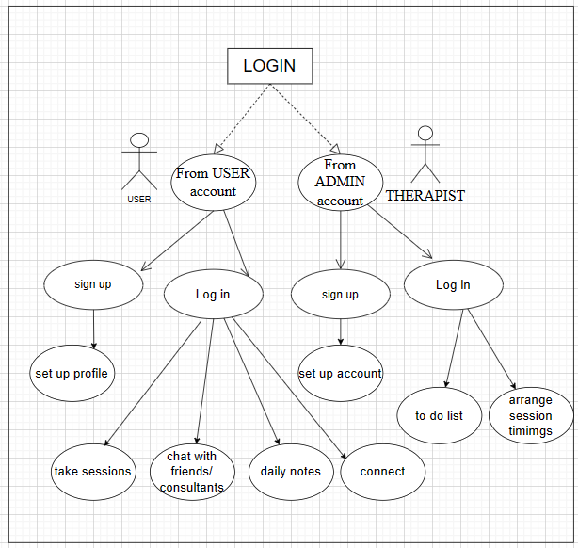
System architecture flow

Slide 7
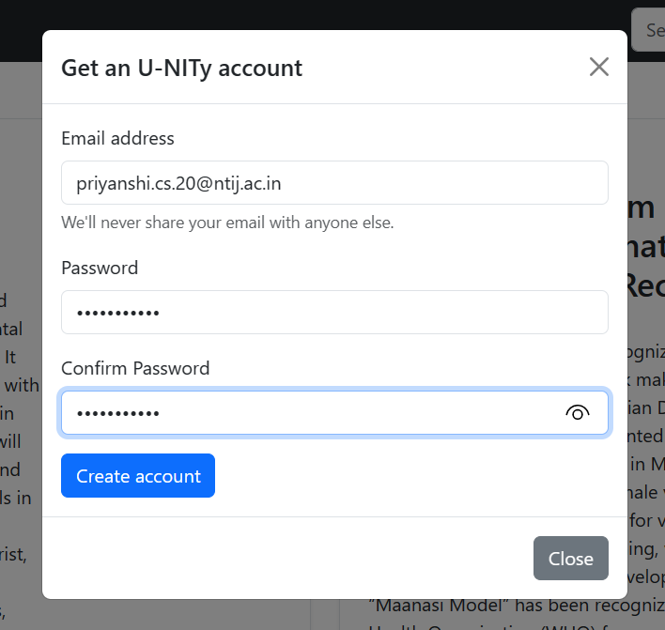
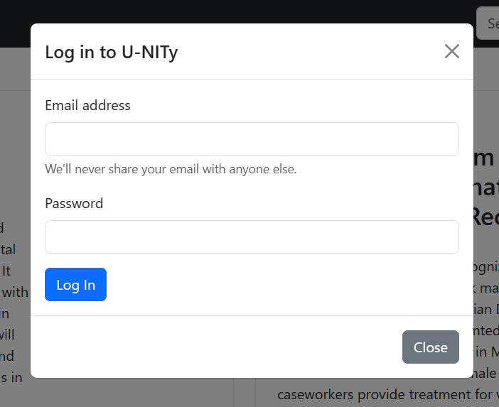
Web application features
Sign-up and Login: When you open the sign-up process, you’ll be required to create a nickname and password and give a valid email address to verify. With the ID and password you can access the platform.

Slide 8
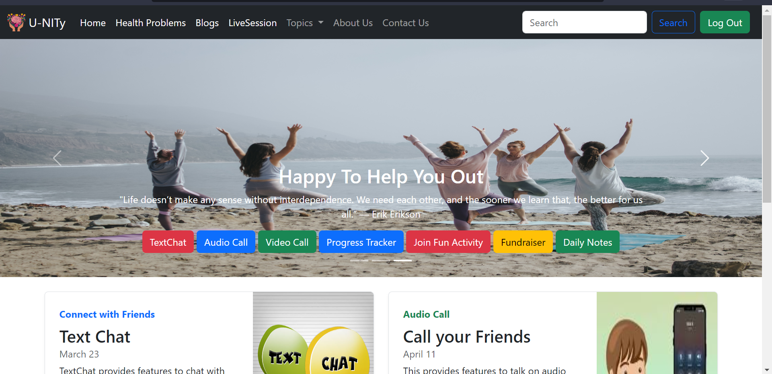
2. Dashboard: Dashboard will help to know about daily activity in a summary way.

Slide 9
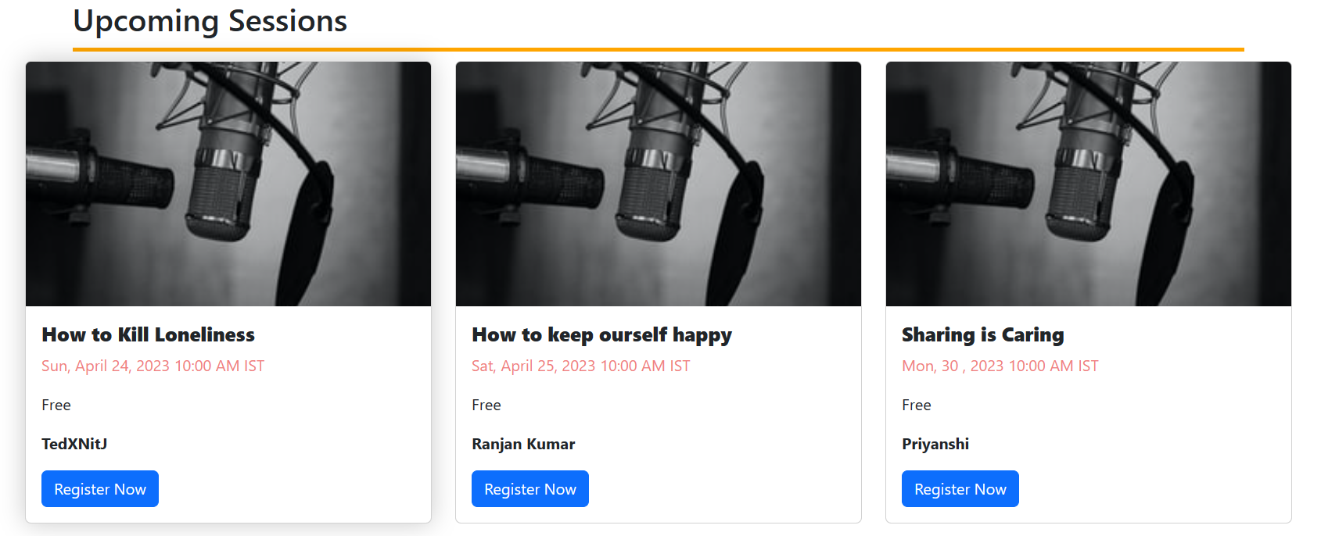
Manage Live Sessions and Podcasts: Admin will have all details about where its live session is going on, who created, time and everything.

Slide 10
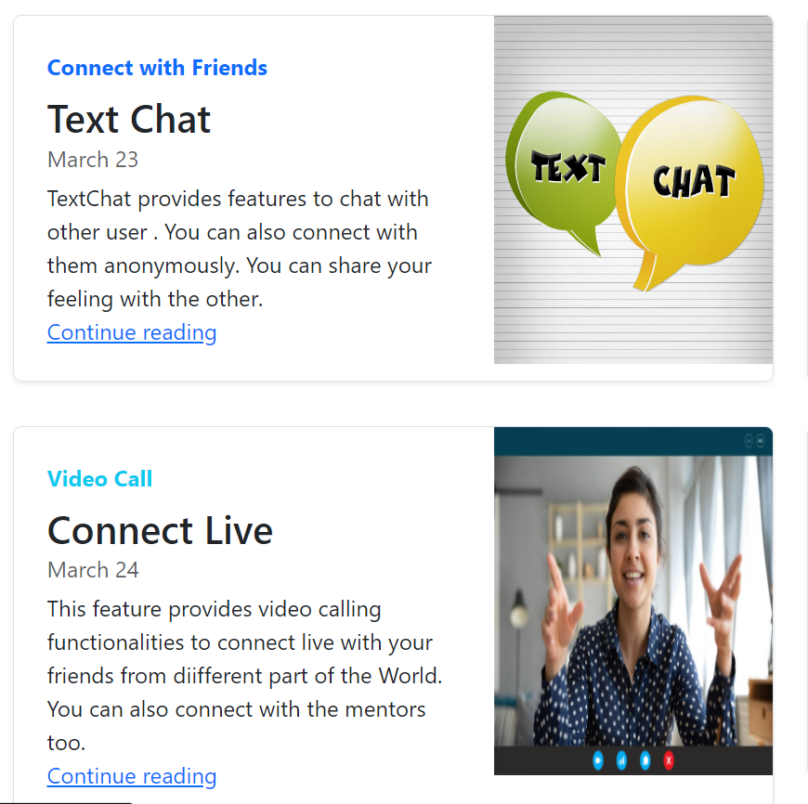
4. Chat Messaging: For clear communication, users will have a text messaging chat, where they can drop a message to a therapist.

Slide 11

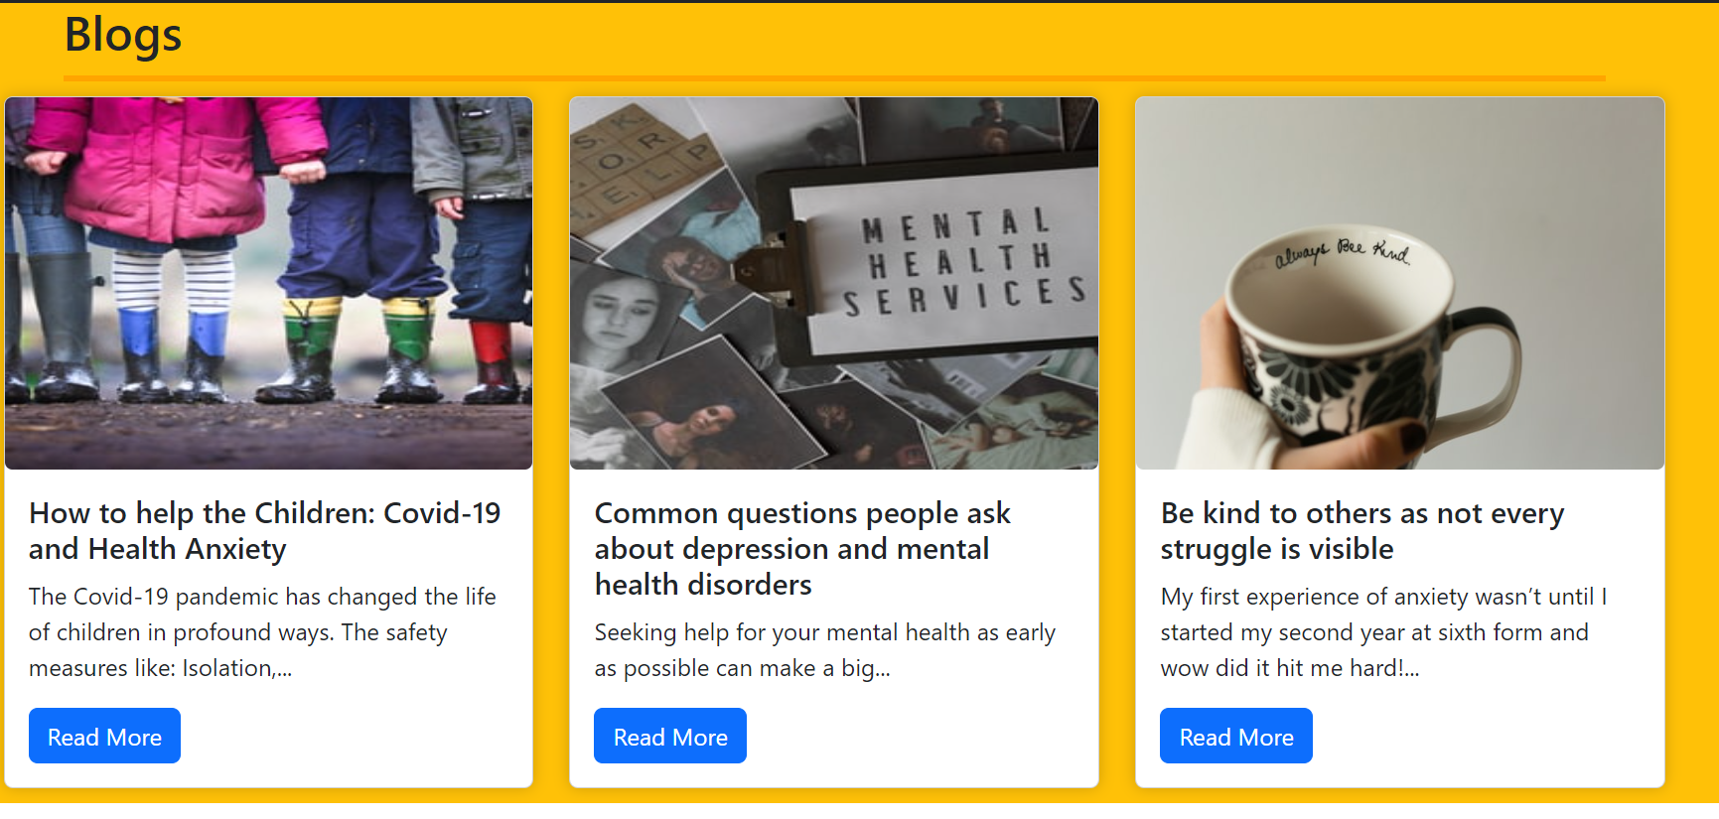
5. Reminder for Plans: This app will track the plan according to subscribers by users and remind them if a plan is going to expire, renewal or days. Also daily diary entry feature is provided to the users to keep a track of their progress.

Slide 12
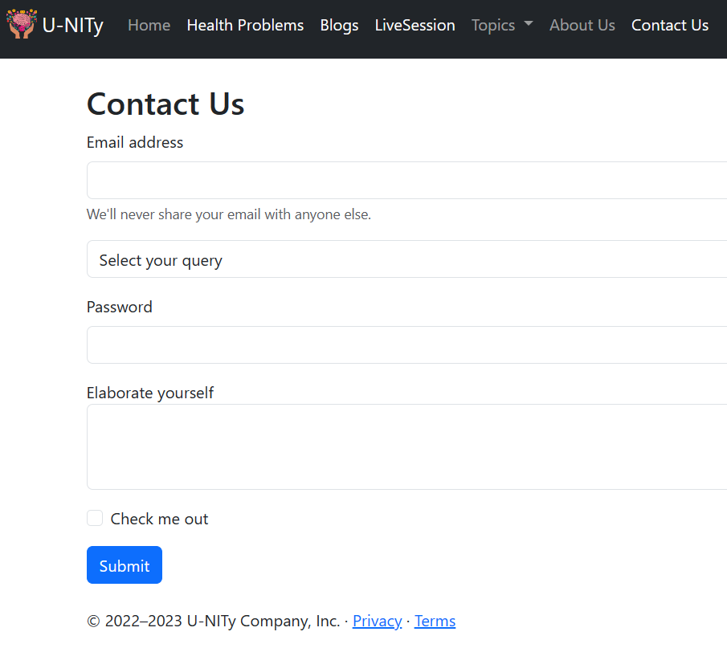
6. Help/Support: Received support requests from users and therapists.

Slide 13
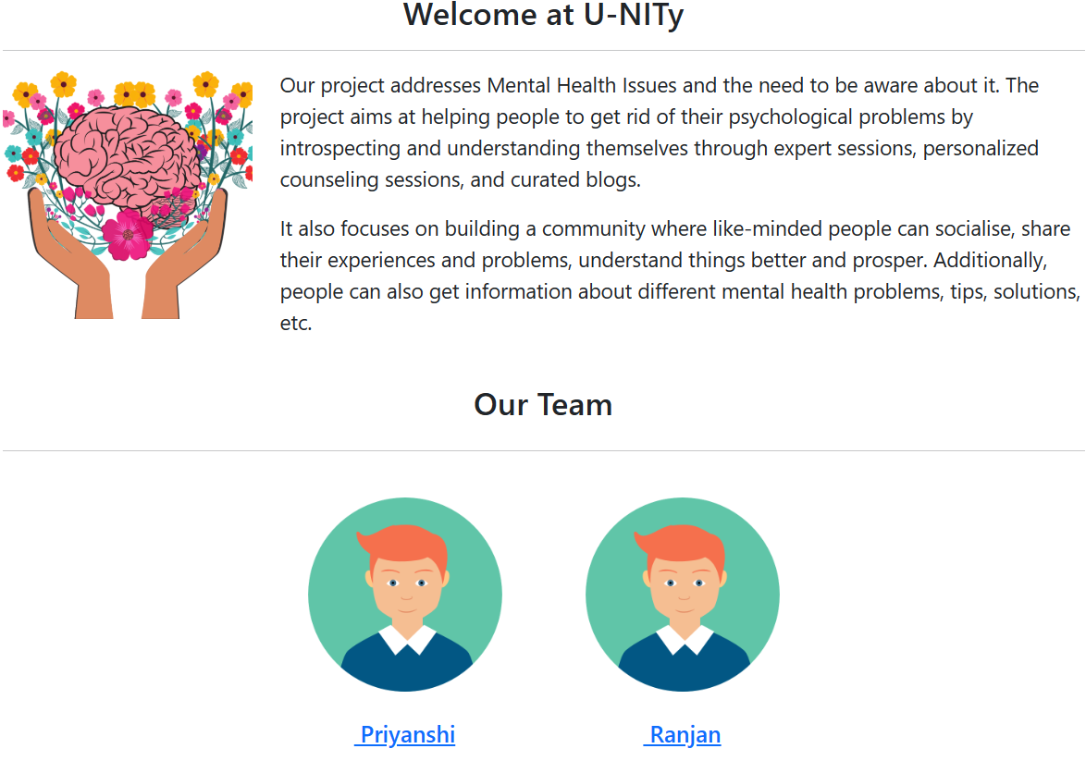

Slide 14
Future Scope
The future scope of an online therapy platform is vast. Here are some potential future directions for this platform:
In future, the same API can be used for mobile application and android development.
Expansion of services: The platform can expand its services to include additional mental health services such as cognitive-behavioral therapy, mindfulness-based therapy, and art therapy. Additionally, the platform can offer specialized services for specific populations such as veterans, LGBTQ+ individuals, and individuals with disabilities.
The platform can offer multilingual support to reach non-English speaking users.
Collaborating with universities and research institutes to conduct clinical trials and publish research papers.

Slide 15

Review of technology
Operating system: Windows 7 or above, Linux, Mac
RAM: 3GB,
Languages (HTML, CSS, Javascript, Python), Framework(Bootstrap, Next.js, Angular JS)
Firebase: Backend-as-a-Service supplier Firebase. It offers various instruments and administrations to help engineers make top notch applications, extend their client base,and bring in cash. It depends on Google's innovation. Firebase is a NoSQL data application that saves data in JSON-like records

Slide 16
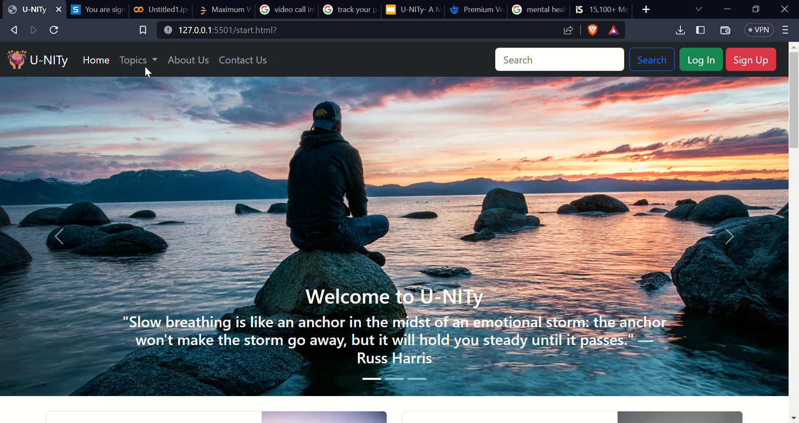
Quick Overview of the Website

Slide 17
THANK YOU

